Slide 1
Product Lifecycle of Paper Towels
by : Anne Horst & Phoebe Kainap

Slide 2
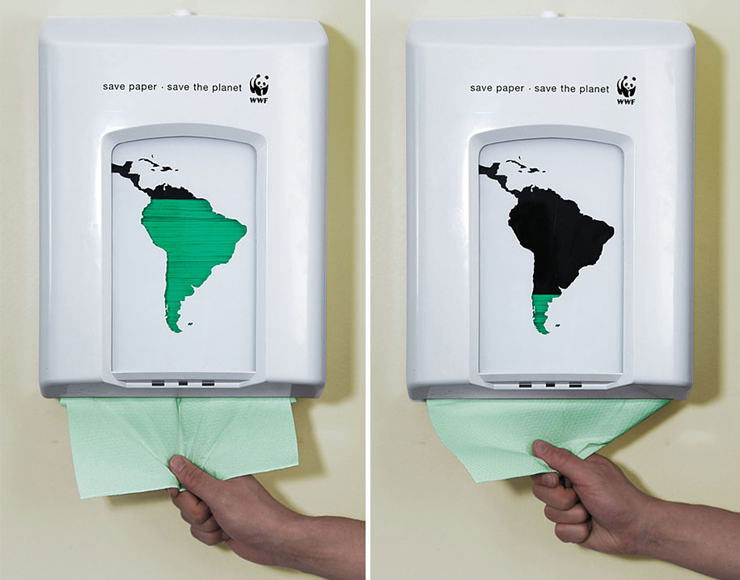
Statistics
North America produces about 50 trillion rolls of paper towels each year
in general the production of paper towels result in the cutting down of 110 million trees per year
130 billion gallons of water usage in the factory
After use all goes into the landfill – some 3,000 tons annually

Slide 3
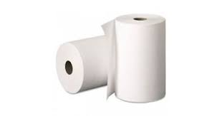
The Product Lifecycle of Tissue Paper
Packaging
Marketing
Recycling
Extraction and Processing of Raw Materials
Manufacturing
Disposal of waste

Slide 4
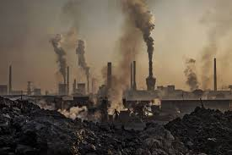
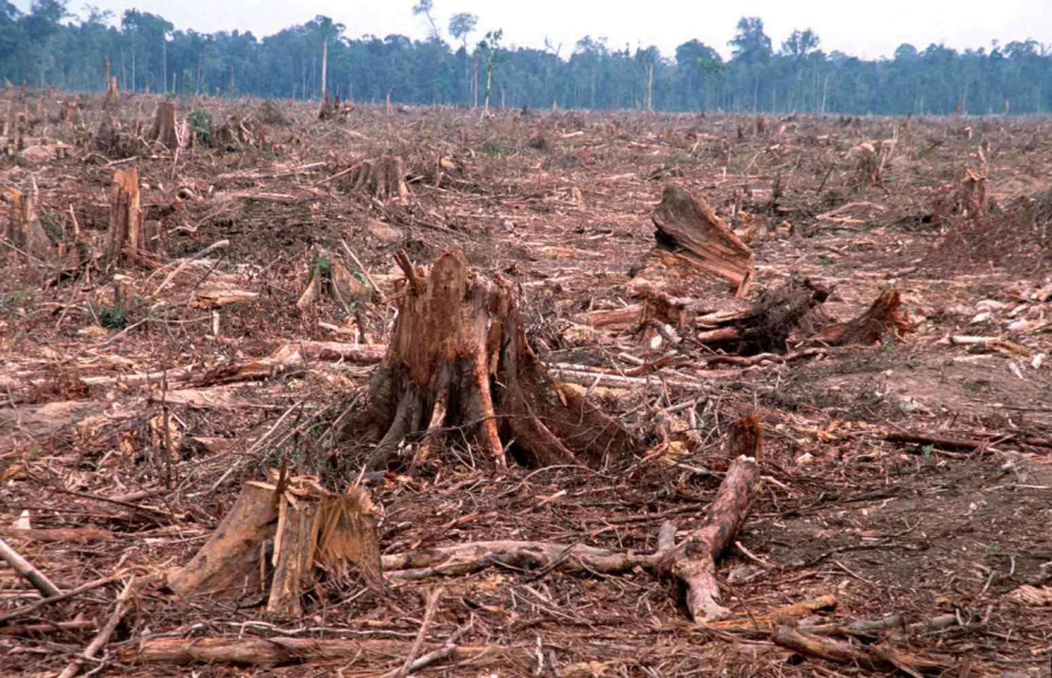
Consequences of Production
Deforestation
GHG’s emission from decomposed landfills (from plastic packaging and product itself)
Pollution (air, land, soil)
Overusing of water
World Issues
Health issues
Do not promote less consumption

Slide 5
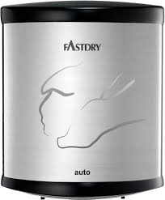
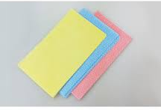
The alternatives to Paper Towels
Electric hand dryers for public washrooms
reusable cloths & napkins
Examples: microfiber, cotton, low-lint cotton, chambray, linen, bamboo
If there’s no alternative: use as less towels as possible to create less waste!!!
P.S. shake your hands well :)

Slide 6
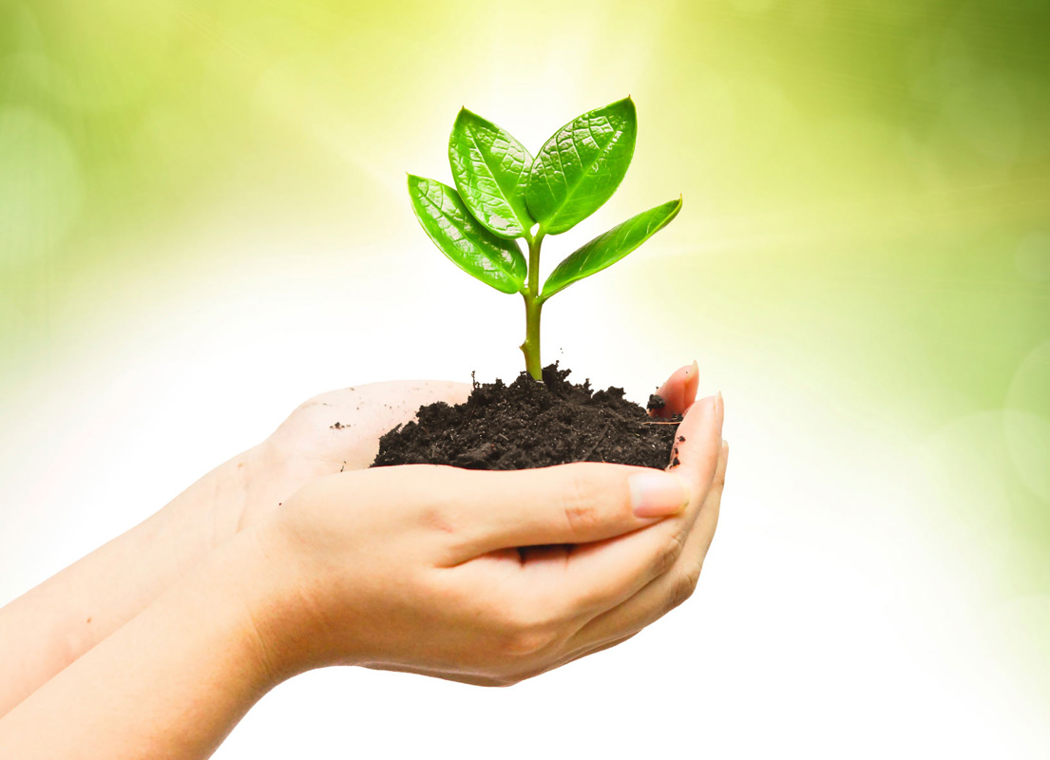
Social Benefits
Creating awareness
Households will save money
Better health, well- being and quality of life
Environmental Benefits
Less waste that goes to landfill
Less trees cut down
Less GHG emission from landfill

Slide 7
Four System Conditions of The Natural Step
1 Dependence on fossil fuels and metals – product manufacturing & burning of waste
2 Use of Chemicals - manufacturing, ex: chlorine for bleaching
3 Destruction of nature - extraction of raw materials ex: Trees
4 Stopping people globally from meeting their needs - exploitation of labor
Notes:
In some cases, there’s a possibility
Since its an industrialized process, the four conditions were met. From using fossil fuels, chemicals, to destruction of nature.

Slide 8
Connection to tourism
- high use of paper towels in Hotels and F&B
- All areas open to tourist such as public washroom uses paper towels
However, some tourism places advocate:
- using fabric towels
- tourist are able to choose to participate in sustainable practices

Slide 9
References
Better Planet Paper, Inc. (2016). Paper Awareness. Retrieved from https://www.betterplanetpaper.com/uearn2/Paper-Awareness
Globecomain. (2015). The Environmental Impacts of Paper Towels. Retrieved from http://durafreshcloth.com/881-2/
How It’s Made. (2015). How It’s Made Paper Towels. Retrieved from https://www.youtube.com/watch?v=G9_51W7igrI&t=119s
www.wwf.ca

