Slide 1




DECORNEST
TEAM MEMBERS:
GURKARANBIR SINGH
GURMAN KAUR
JASKIRAT SINGH WADHWA

Slide 2

Online Interior Designing Studio
Decorating, Renovating, and Styling
Different design Aesthetics
3D visualisation software
Creative and Skilled professionals

Slide 3
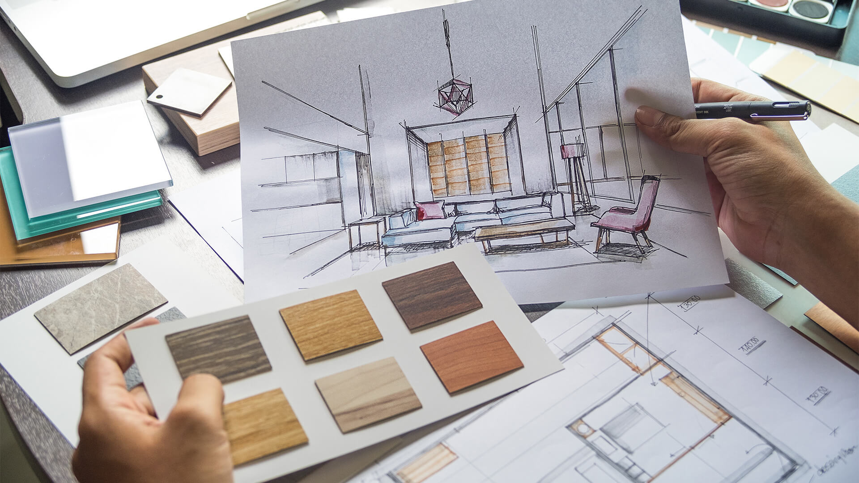
The website has 3 functions:
Design / Decorate your own space
Consult with a professional– the “Book an appointment”
Client Sourcing / Networking for independent freelancing interior designers.

Slide 4
PRICES
FOR PEOPLE WHO WANT TO DESIGN SPACES:
DESIGN / DECORATE YOUR OWN SPACE:
First 20 minutes – Free (DEMO)
3 hours – $3.99
24 hours – $6.99
1 week – $11.99
BOOK AN APPOINTMENT: $40
FOR PEOPLE WHO WILL HELP DESIGN SPACES:
ACCOUNT CREATION (for interior designers) subscriptions:
Yearly: $99.99
Monthly: $11.99
*A 5% commission will be charged on every furniture piece purchased from the supplier.

Slide 5
Problem and Opportunity
Time saving
Project Management
Efficient use of space
Budget friendly designing

Slide 6
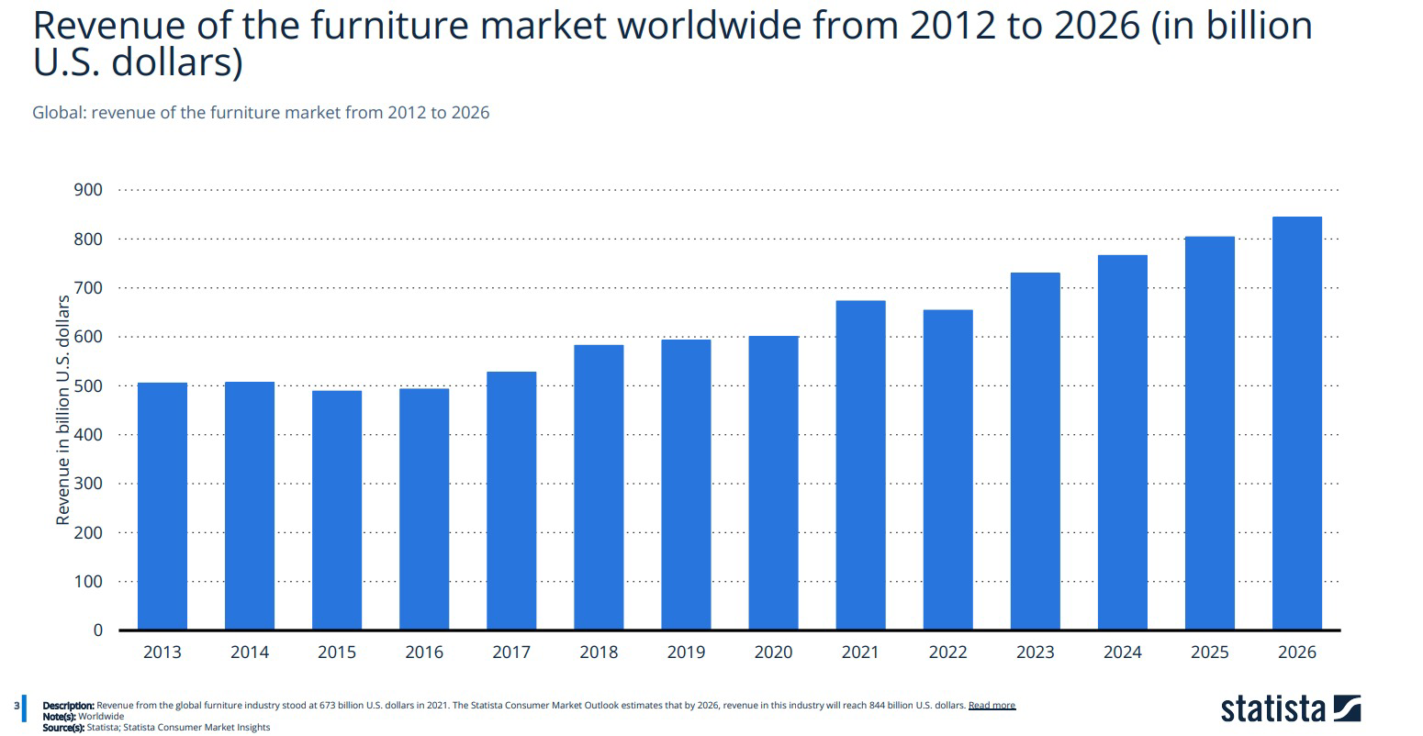

Slide 7
COMPETITION
IKEA
Well established Interior Designing firms
DIFFERENTIATION
Virtual studio
Quality furnishings
Discounted prices
Professional designers

Slide 8


Target Market
Residential Clients
Commercial Clients
Interior designers
Real Estate Agents
Property Management Companies
Location: Canada
The Global interior design market is expected to reach over $339 billion by 2027.
45% of the specialized design service sales in Canada come from interior design.

Slide 9





Operations
Consultation
Space Planning
Concept Development
Procurement
Project Management
Installation and Styling

Slide 10
Finances
Website: $20,000
Salaries: $10,000
Marketing & Promotion: $8,000
Operations: $2,000
Total: $40,000

Slide 11

INITIAL INVESTMENT:
$40,000
FINANCIAL PLAN
$35,000 sourced as a loan @ 5%.
$5,000 from personal savings.

Slide 12
THANK YOU!

