Slide 1
Welcome to Blog-o-Rama
Writing Workshop September 12, 2018

Slide 2
Writing is________.

Slide 3
Rewriting.

Slide 4
But we start with pre-writing.

Slide 5
Why are you writing?
What’s the purpose of the blog post?
Information?
Persuasion?
Instruction?
Education?
Entertainment?

Slide 6
Who are you writing to?
Who is the target audience?
General public?
Foodies?
Cat lovers?
Tech geeks?
Hovering Parents?

Slide 7
What’s in it for them?
Why should they care?
How will they benefit?
The “You” Attitude

Slide 8
1 . Create a Structure

Slide 9
Structure = Outline
Beginning
Middle
End
1 idea per paragraph

Slide 10
OK, now we write
What’s the main message? (aka your topic sentence)
What are the top 2 to 3 supporting facts or ideas?
What’s the conclusion or call to action?
(and attribute MLA style as we go)

Slide 11
2. Add leaves and flowers
Images, videos or links

Slide 12
… and Rewrite

Slide 13
Why headlines (clickbait) are key
On average, 5 X more people read
the headlines as read the body copy.

Slide 14
Short and scannable
Average blog readers stay 96 seconds per blog.
Only 16% of people read web sites word for word.
The average person only comprehends 60% of what they read.
http://www.problogger.net/how-to-write-great-blog-content/

Slide 15
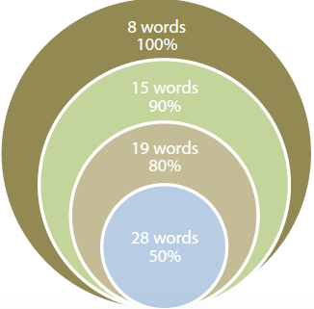
The Magic of 8

Slide 16
Less is more
Limit sentences to approximately 20 or fewer words to ensure impact.
American Press Institute reports that reader comprehension drops off markedly as sentences become longer.
Think about the relationship between sentence sprawl and comprehension

Slide 17
Short shorts 1
No fillers or additives …
kind of
really
actually
basically
practically
generally
various
particular
very
important
Etc.

Slide 18
Short shorts 2
Be ruthless with redundancy
basic fundamentals
various different
true facts
each individual
consensus of opinion
few in number
final outcome
future plans
Personal opinion
end result

Slide 19
Short shorts 3
Verbs, not verb plus noun
Conduct a discussion of Discuss
Create a reduction in Reduce
Give consideration to Consider
Make an assumption of Assume
Perform an analysis of Analyze
Take action on Act

Slide 20
No, no, no I don’t wanna go to rewrite
Do not write in the negative Write in the affirmative
not different similar
not allow prevent
not stop continue
not include omit
not often rarely
not notice overlook

Slide 21
Be active, not passive
Use the active voice for most business writing
Use the passive voice to emphasize an action (the verb) or the recipient of the action (the object). (Drug tests are given to all applicants)
Use the passive voice to deemphasize the doer in negative news. (Your smart phone cannot be repaired)
Use the passive voice to conceal the doer of an action.
(Mistakes were made)

Slide 22
Make it easy to read
1 Headings
2 Bullets
3 Numbered lists
4 White space/paragraphing
5 Boldface, italics, capitalization, colour

Slide 23
Revise (as in rewrite)
Print a copy. (Set it aside for at least a day if you can).
Read it out loud.
Proofread carefully.
You will find errors.
Read the message at least twice: once for meaning and once for grammar/mechanics.
Read slowly. Concentrate on individual words rather than ideas.
Re-read the document -- from end to beginning.
Turn off the computer screen while you type to overcome writer’s block/perfectionism
Add, delete, or rearrange material accordingly.
Have someone read the blog aloud to you.

Slide 24
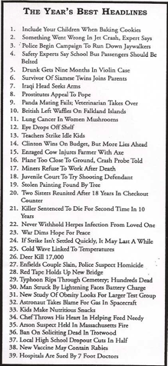
When words (and grammar) go bad

Slide 25
Huy chexw.
Thank you.
Merci.
谢谢
Muchas gracias
谢谢
ਤੁਹਾਡਾ ਧੰਨਵਾਦ
Salamat
고맙습니다
Cảm ơn bạn

